Slide 1
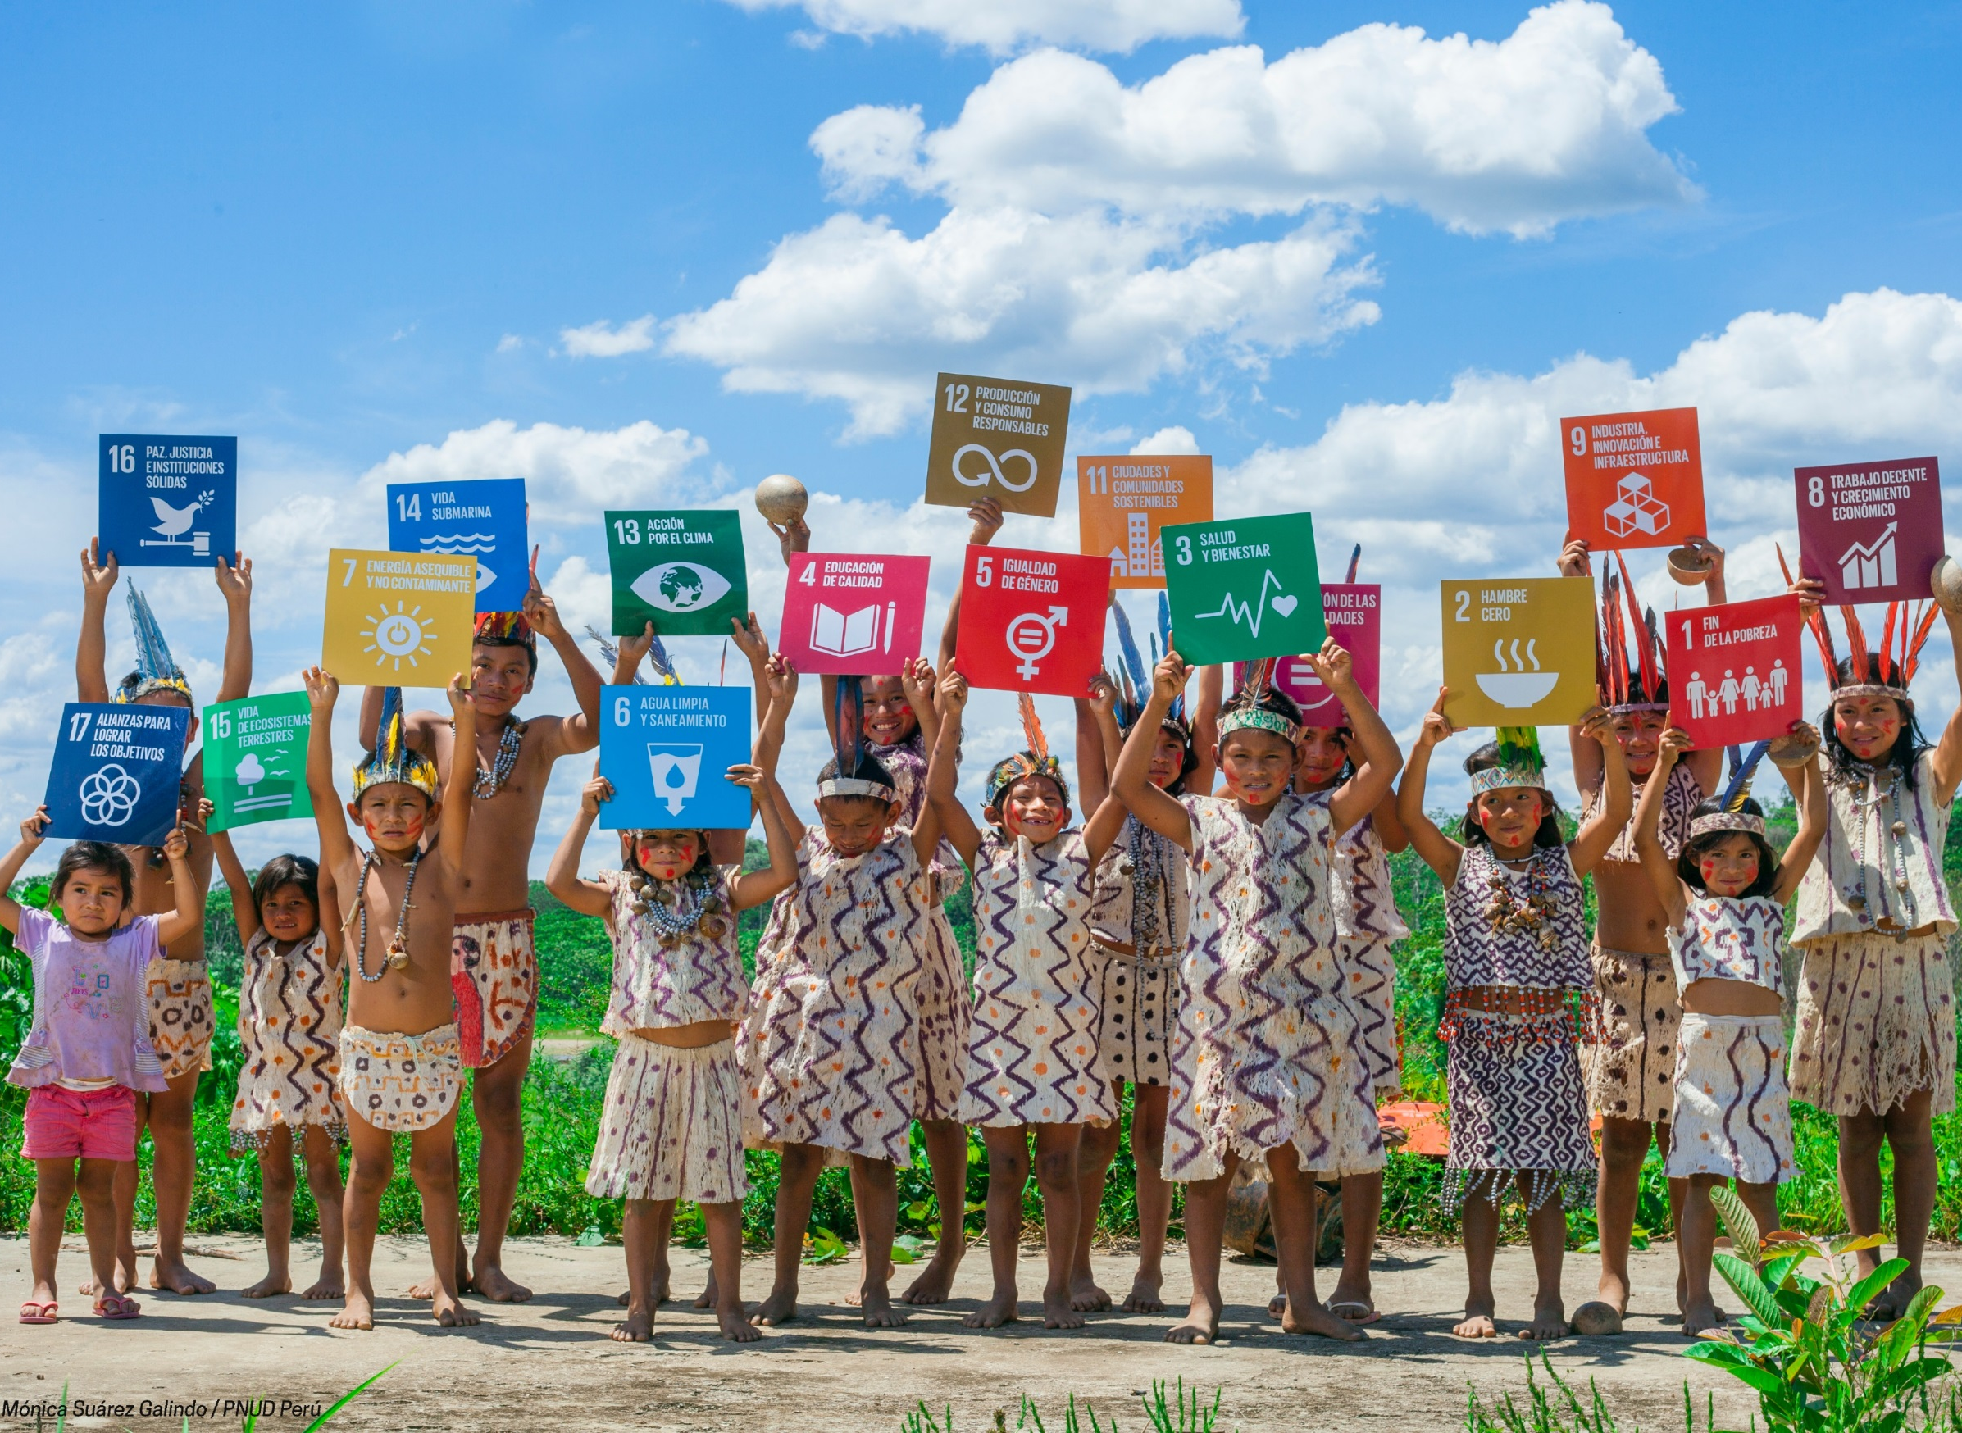


Sustainable Development Goals
How do we get there –
People and Leadership
SIG Meeting, Copenhagen, 22 June 2017

Slide 2

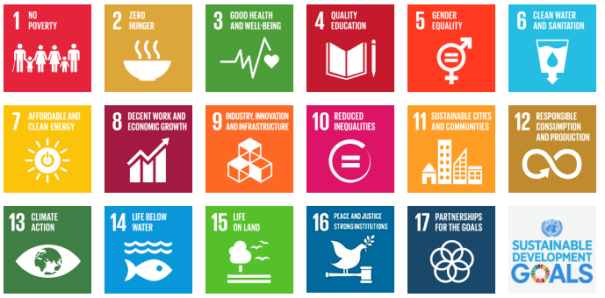

Slide 3
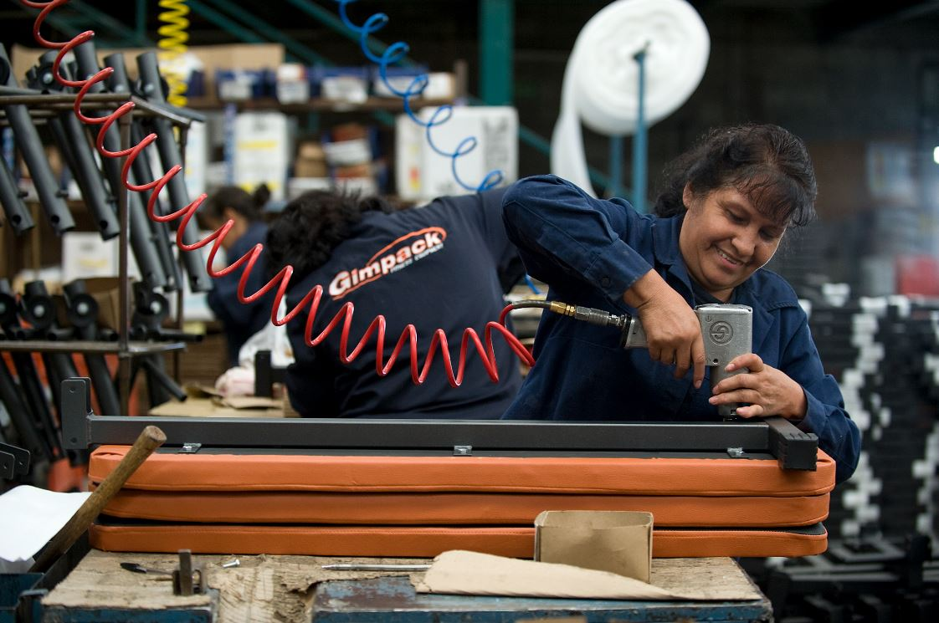
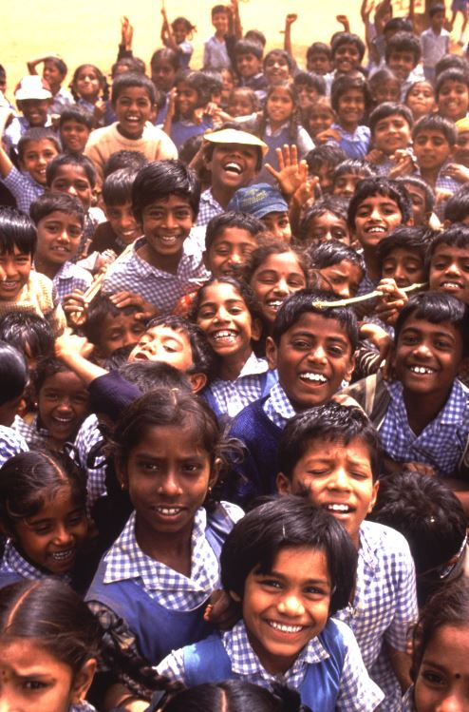
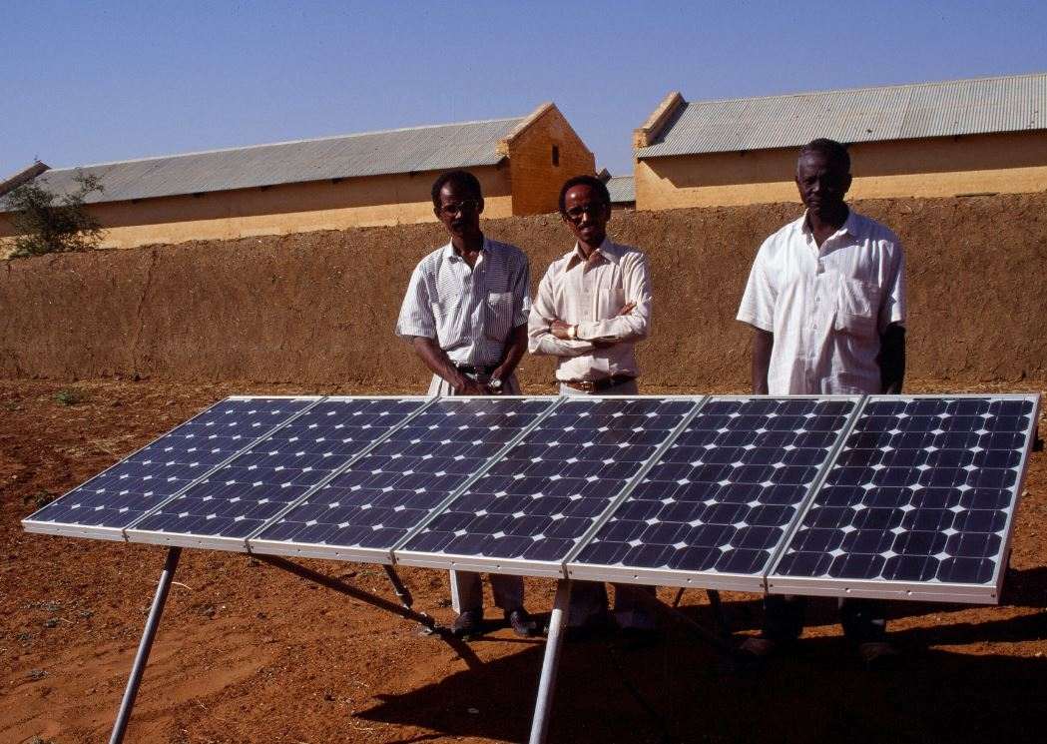
Economic
Growth
Social
Development
Environmental
Protection

Slide 4
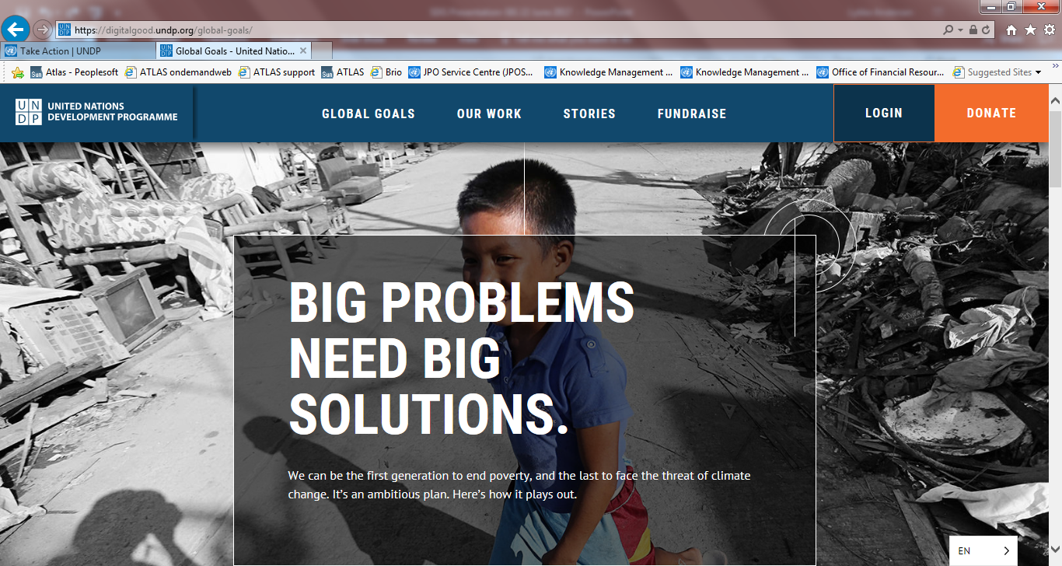
https://www.youtube.com/watch?v=Mdm49_rUMgo
Notes:
https://www.youtube.com/watch?v=Mdm49_rUMgo

Slide 5

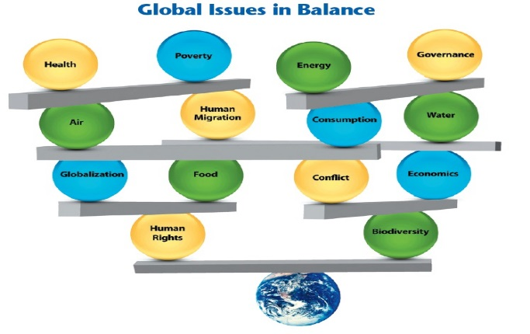
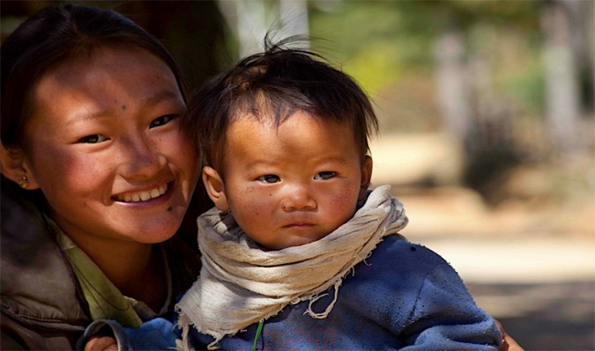

SDG AGENDA PRINCIPLES
UNIVERSALITY
INTEGRATION
‘NO ONE LEFT BEHIND’
© UNDP – ‘Getting ready to implement the 2030 Agenda’
Implies that goals and targets are relevant to all governments and actors: integration
Universality does not mean uniformity. It implies differentiation (What can each country contribute?)
Policy integration means balancing all three SD dimensions: social, economic growth and environmental protection
An integrated approach implies managing trade-offs and maximizing synergies across targets
The principle of ‘no one left behind’ advocates countries to go beyond averages.
The SDGs should benefit all – eradicating poverty and reducing inequalities.
Promotion and use of disaggregated data is key

Slide 6
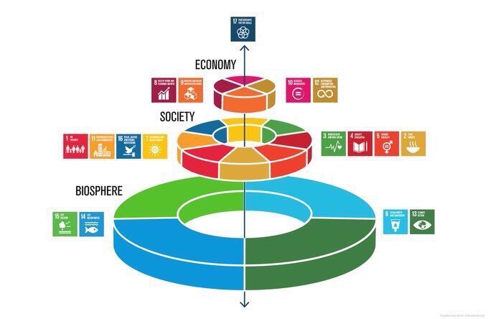
2030 AGENDA REQUIRES PARTNERHIP - NATIONAL COMPACT
SRI LANKA: ACHIEVING THE SDGs REQUIRES MULTI-STAKEHOLDER ENGAGEMENT
169 SDGs TARGETS
135 targets
National Governments
54 targets
Demand international cooperation and coordination
88 targets
Require an active role of private sector
110 targets
Require actions by local governments (vertical coherence)
Civil society engagement across the agenda

Slide 7
WHAT DO WE NEED TO GET THERE?
Policies
Partnership
People
Institutions
Leadership
© UNDP – ‘Getting ready to implement the 2030 Agenda’

Slide 8

UN LEADERSHIP FRAMEWORK
Call for Action – Call for Change
Defines the UN leadership culture aligned with Agenda 2030
Applies to all staff, at all levels, in all locations
Can serve to catalyse culture change
Helps UN entities come closer together
© UNDP – ‘Getting ready to implement the 2030 Agenda’

Slide 9
8 CHARACTERISTICS OF UN LEADERSHIP
Norm-Based
Self-applied
Principled
Collaborative
Inclusive
Accountable
Transformational
Multidimensional
© UNDP – ‘Getting ready to implement the 2030 Agenda’

Slide 10
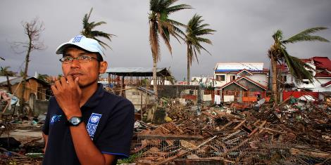
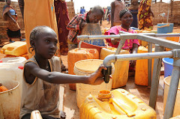
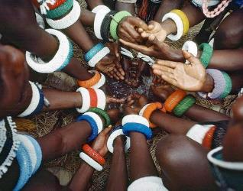
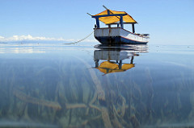
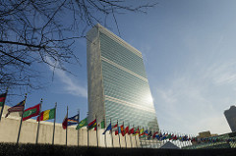
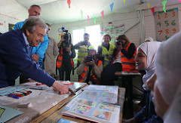
LEADERSHIP BEHAVIOUR
Focusing on impact
Driving transformational change
Systems thinking
Co-creation
© UNDP – ‘Getting ready to implement the 2030 Agenda’

Slide 11

OPERATIONALIZING THE FRAMEWORK
Adopted by CEB in April 2017
Aligning the organizational cultures of UN agencies to the framework will require a culture change effort
It will consist of:
A limited number of high-impact system-wide interventions
Interventions by participating UN entities
An online platform to publicize progress
© UNDP – ‘Getting ready to implement the 2030 Agenda’

Slide 12
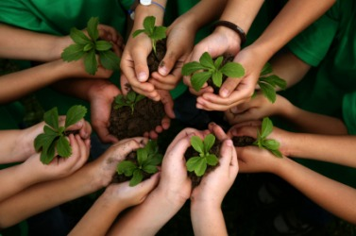


THANK YOU
© United Nations Development Programme

